Slide 1
Game & Level Design Prototyping
Ingredients

Slide 2
Ingredients
Ingredients is a term picked up from working with French game developers for several years.
It is an excellent way to describe the parts of a level that make up the gameplay, rather than the parts that make up the obvious architecture and framework.
The ingredients of your level are all the elements afforded by the designer's vision.
It might be creatures, it might be weapons available in the map, or other items.
It might even be the kind of encounters the players are allowed to have.
Some levels rely heavily on combat encounters.
Other games require that a level designer create situations that allow the player to sneak by adversaries.
Sound effects are ingredients, as are moving platforms and elements that the level designer can use in combination to create interesting variations on the same theme.
Simply jumping from one platform to another can be fun initially but quickly gets boring if that's all there is to do.

Slide 3
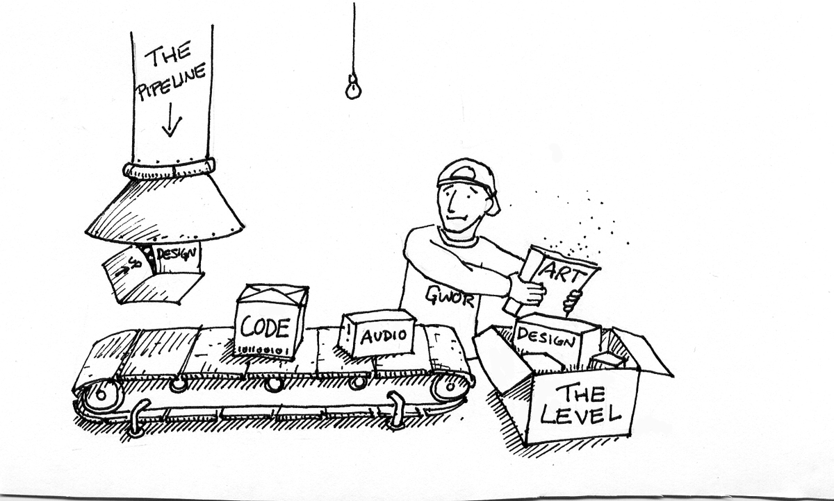

Slide 4
Ingredients
By creating twists on a theme, sometimes having a platform give way when the player lands on it, or having one or both platforms moving, or invisible platforms that only appear every few seconds, and so on.
You can't be expected to come up with a whole level full of unique ideas, that's like writing a book with a completely original plot, an impossible task.
On the other hand, you will be expected to think quickly as you design to come up with different and interesting ways of turning the raw ingredients of the game into exciting and entertaining encounters.
In this way, level design is like creating a great soup, it's not simply the acting of adding ingredients into a container and heating.
The different ingredients need to enhance each other, combine to create good flavor and texture, and come out much greater as one than they were alone.

Slide 5
Designing Ingredients
The elements of your level might not all be handed to you by the designer.
Level designers frequently need to supplement the list of game ingredients, or make up new ones to make a game experience work properly.
If you are responsible for creating the ingredients in your level, designing the kind of creatures the player will combat or the powerups available, you will need to provide the information needed to the art and programming teams.
Common pieces of information for a map element you are creating are the following:
Purpose: Is this entity a character, a weapon, a piece of a puzzle?
Goal: What is the reason for the ingredient to exist? Is it to destroy players, or heal them? Is it there simply to be pressed so a door can open?
Visual Description: What does it look like in the game?
Special Animations: Is this the only enemy in the game that can headbutt the player character? If so, the animation team will need to create special anima­tions for it.
Availability/Occurrence: Where will this ingredient show up? Is it just for one specific level, certain geographic locations, or anywhere in the game? It may be that something you design is useful to another level designer, so make sure you clarify restrictions on where it should and should not be used.

Slide 6
Designing Ingredients
Placement Considerations: Where in a level should this go? Should it be grouped in pairs, or should it only be found alone? Is it rare or common? Is it contained in crates the player has to smash or can it be found in the street?
Attributes: Is this ingredient a character with health, armor, and ammunition that needs to be set? If so, how much of each? Is it randomly determined? You will need to outline the common game attributes that are used by this entity.
Special Properties: Is there something that it does that nothing else in the game does? If so, give a brief description and lay out how the attributes should work so that the programmers can set it up properly. For example, if you are designing a Mud Monster who needs to be destroyed with soap, you might need to give him a cleanliness metric instead of health. Normally, soap won't harm an enemy character in the game, but the Mud Monster is programmed specifically to detect when a soapy projectile hits it and increase his cleanliness attribute until it reaches 100%, at which point the monster is defeated. You might lay this information out as shown here:

Slide 7
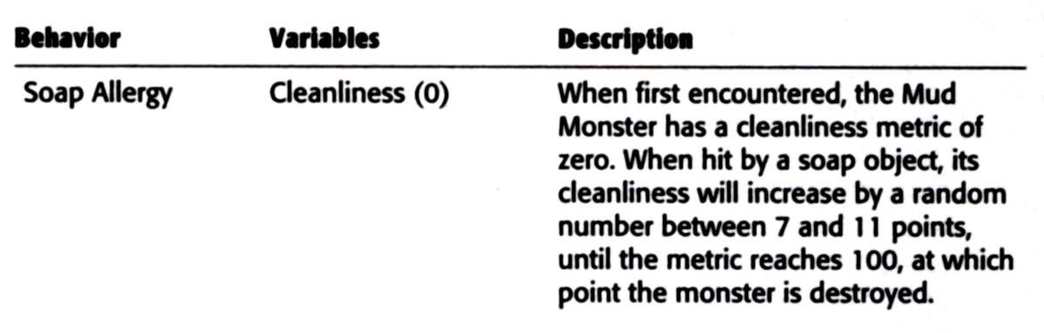

Slide 8
Physics As Ingredients
The use of real-time physics in games is almost a standard feature, with technology available that is able to efficiently calculate very complex predictions about how things in a game should behave when in motion.
Some games use physics in a purely decorative way, the bodies of enemies using "ragdoll physics" to fall down stairs or over railings when they have been shot, for example.
Other games use physics to enhance the core gameplay, especially for genres like car racing, where real-time physics allow the cars to behave realistically on the road and in collisions.
The Burnout series of racing titles uses incredibly real physics to create intense multivehicle crashes.
Using physics-enabled ingredients in your levels can be a challenge.
Until recently, games used animated geometry to simulate the real-world motion of ingredients.
A giant rolling boulder to chase the player was set by the level designer to move between certain points or follow a prescribed path.

Slide 9
Physics As Ingredients
It would behave exactly the same way every time the level was played.
With the same ingredient using physics, the results of its movements become much less predictable, and the boulder may careen off into a nether region of the level, or the player may be able to block it by throwing a large object in its path.
If that boulder is needed to break through a wall to allow the player to access the next section, both these cases will result in the game being stuck.
This means that any time you are thinking of using a physics-based ingredient for an encounter, you must plan very carefully for how to constrain the situation and control the outcome enough that the experience remains a positive one for the player.
On the other hand, if you spend too much time building fail-safes for a physics ingredient, you probably would have been better off using a scripted sequence in the first place.
Use physics carefully, and in situations where it is appropriate.

Slide 10

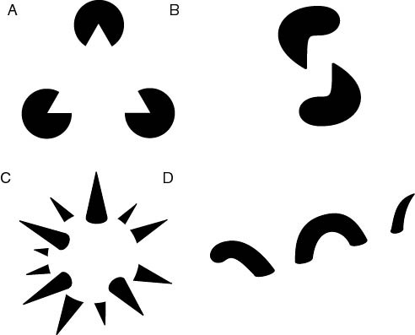

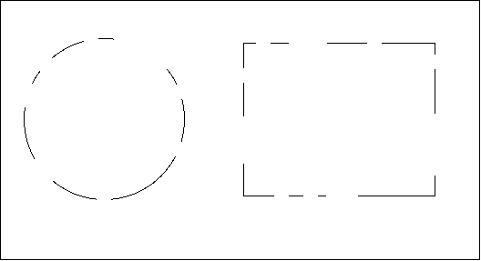
Gestalt

Slide 11
Level Gestalt
Gestalt is an obscure word, generally defined as "a group of elements so unified that it can't be described as just a sum of all of its parts."
In the context of a level designer being responsible for putting all the elements of the game together, it is a perfect description of what a level needs to be.
A game level needs to be something greater than the gameplay, textures, props, and lighting within it.
As these work together to support and enhance the critical encounters and tension in the level, they combine to create an experience that transcends just an environment with things to do, they become a world full of possibilities.
In practice, level design gestalt is about not focusing too much on one area, and knowing what the player will willingly ignore, and what they will not be able to resist.
It is balancing the elements against each other to create a great level in the time, and with the resources, allowed.
You almost never have time to give an equal amount of attention to everything in the level so seeing the environment as a player will and adjusting it accordingly will become a frequent obligation.
For now, just keep gestalt and the balance of ingredients in your mind as you think about the level and what you will be putting in it.
As the process continues, it will become increasingly important to look at the level as the gamer rather than as the creator, and pay more attention to things the closer they lie to the critical path.

Slide 12
References
http://en.wikipedia.org/wiki/Gestalt_psychology

